Slide 1
QMFM Forecast Presentation
23 December 2022

Slide 2
3. Monetary policy instruments (money markets rates) outlook 3.1 Policy interest rate (model uses IB rate)
Interbank (IB) rate and Trend
Interbank (IB) rate drivers (policy rule)
The Central Bank Rate (CBR) policy rate aims to influence the interbank (IB) market rate (IB rate steered to policy target to minimize inflation and output pressures).
In pre-Covid 2017-19, IB rate was below its trend level. During 2020-21, despite negative inflation deviation and output gaps, rates were reduced little and can only be “explained” by positive shocks.
During 2022, policy rates were raised between 4.5 to 6% (6.5 % in Nov 2022) as a response to hiking inflation (tuned 6% to 6.5% for Q4 2022 and Q1 2023, respectively).
After 2022, the combined effect of recent shocks-induced inflation surge (expected to subside in 2023-24), and expected inflation {4Qo ahead} falls will contribute to a moderate interest rate around its 6.5 % trend

Slide 3
3.2 Real policy interest rate (RIR, using IB rate) and lending rate
RIR (IB rate) and trend, %
RIR (IB rate) components, %
The movement in the RIR (as affected by NBR policies against inflation—changes in IB rate) is transmitted to the RIR for private demand.
In the forecast, the policy rate and RIR are expected to rise back to their trend levels in 2023-24 and, with the average lending rate following, exert upward pressure on private demand.
Onward after 2024, the model interest rate moves up close to IB trend (determined by trend foreign RIR (0%), country risk premium (2%), and inflation target (4.5%).
Notes:
RIR, level is calculated as the forward average over 4 quarters plus a time-varying lending premium (+8% points above the IB rate). RIR trend drives final demand in the long-run.

Slide 4
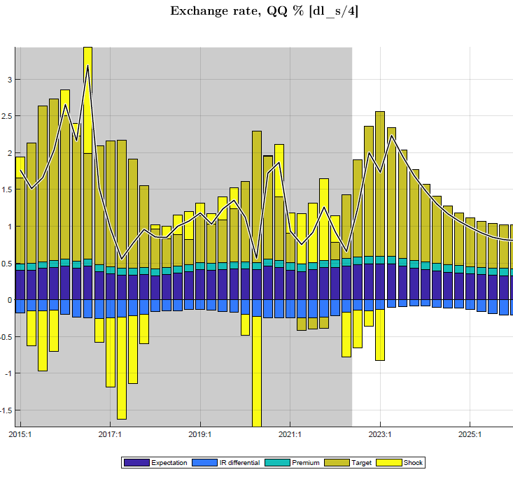
3.3 Real and nominal exchange rates (ER & RER) ER is set (“tuned”) for Q4 2022 and Q1 2023 based on NBR projection.
After a sharp decline since mid-2021 (a real appreciation, driven by the surge in CPI core),
RER is forecasted to gradually rise back to its (zero) trend level during 2023, with a positive impact on demand (net exports)
RER depends on nominal exchange rate volatility (along with inflation) driven by its shocks and positive exchange rate target.
Forecast RER gradually converging to zero depreciation target after 2023-24 ---reflecting a favorable positive impact on final demand (i.e., NE)

Slide 5
3.4 Real policy rates vs. Final demand summary
The real interest, RIR (Interbank rate):
The RIR forecast rises (albeit from a low negative level) and exerts a weak upward pressure on final demand(i.e., private demand).
The real exchange rate, RER :
RER is forecasted to rise from a low, negative level and exert weaker downward pressure on final demand. Both drivers of private demand are influenced by the NBR for output stabilization reasons while steering them to the trend and steady-state levels (determined outside the model).
Both return gradually to their steady states of RIR of 2% and RER depreciation rate of 0%, resp.

Slide 6
THANK YOU

